Slide 1

Cab Investment insights-G2M strategy
ashwinibn3@icloud.com
Ashwini B N
Intern 2025
14 June 2025

Slide 2
Executive Summary
XYZ, a private investment firm, is evaluating two major cab companies—Yellow Cab and Pink Cab—for a potential strategic investment.
This analysis leverages customer demographics, trip transactions, payment methods, and city-level population data from 2016 to 2018 to assess market performance and growth potential.
Key trends in user engagement, profit generation, ride frequency, and city-wise demand were identified using exploratory data analysis and feature engineering techniques.
The insights derived support a data-driven investment recommendation, highlighting the company with stronger financial performance and long-term market opportunity.

Slide 3
DATASETS USED
Cab_Data.csv – Trip-level data including fare, distance, cost, and company.
Customer_ID.csv – Demographic data (age, gender, income).
Transaction_ID.csv – Mapping between customers and trips, with payment modes.
City.csv – City-level data including population and cab user counts.
Techniques applied
Created a master dataset by merging transactional, customer, and city-level data
Conducted data cleaning and created new features (e.g., Profit, Profit Margin, Price per KM)
Executed Exploratory Data Analysis (EDA) using visual tools like boxplots, histograms, bar plots, and line charts
Performed segmentation by company, city, gender, age, and income to identify usage and profitability patterns
Tested business hypotheses to guide investment decision-making

Slide 4
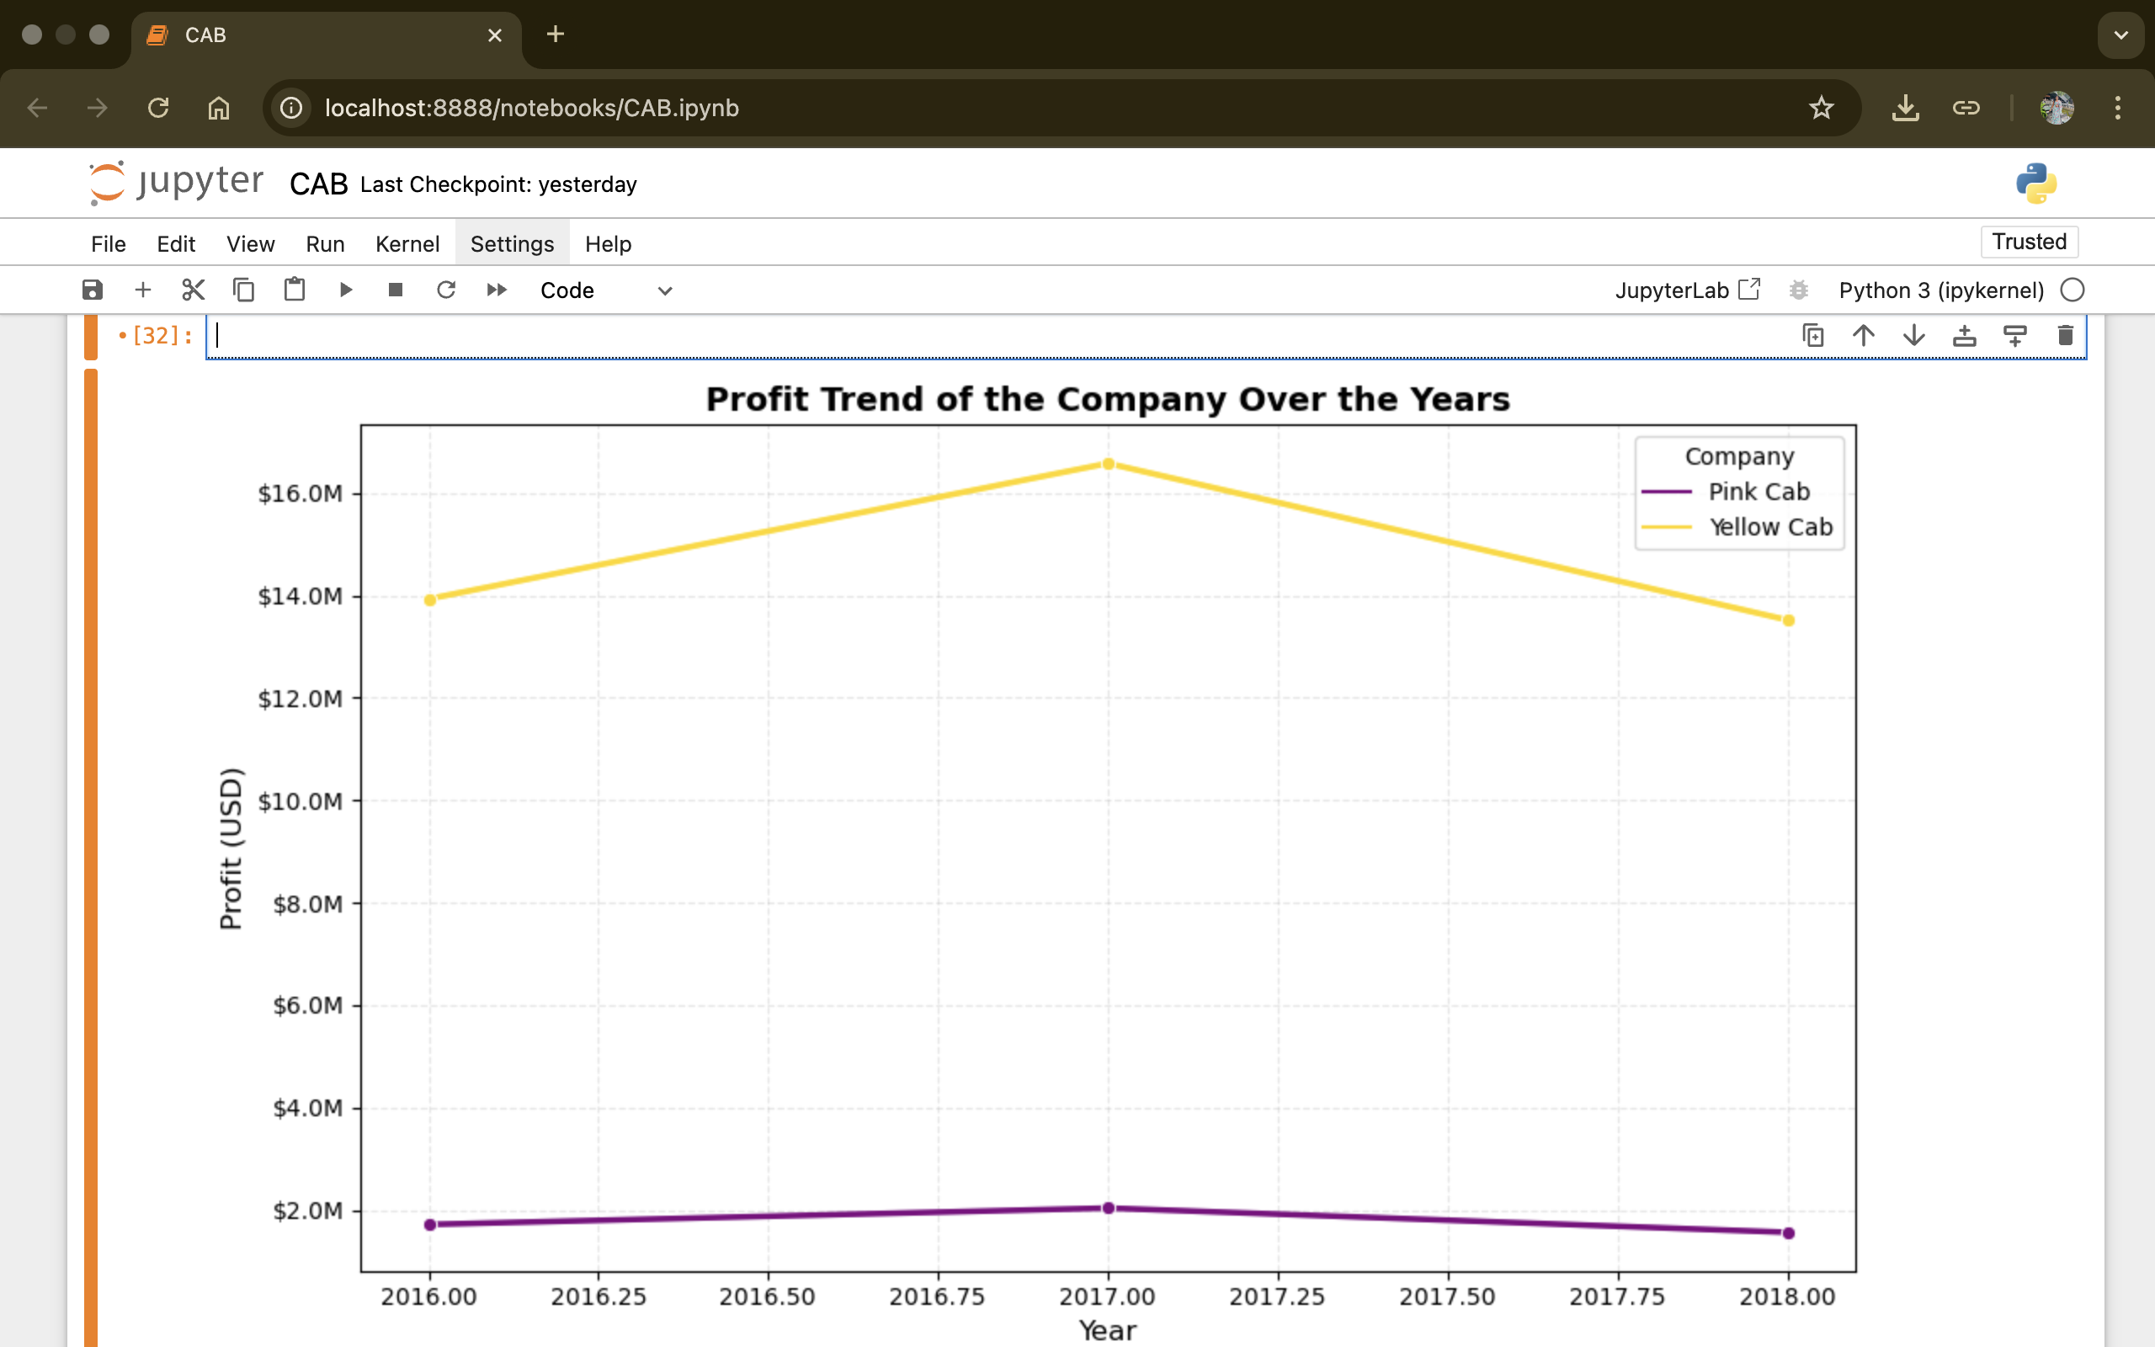
EDA(Exploratory Data Analysis)
1. Profit Growth Trend (2016-2018)
Line chart of yearly profit by company
Yellow Cab consistently outperformed Pink Cab in annual profits, indicating stronger financial stability and market performance.

Slide 5
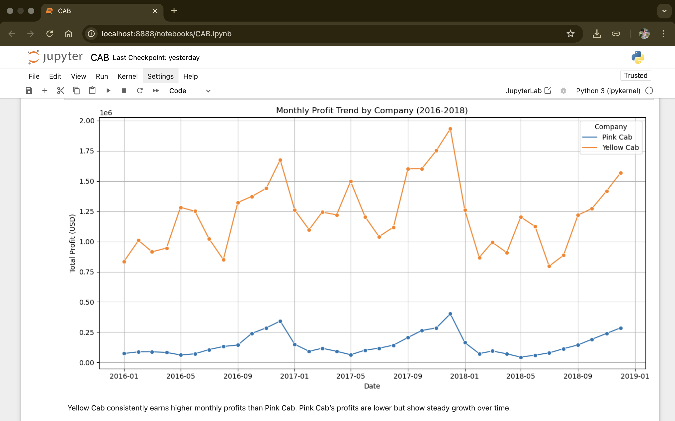
2.Monthly Rides Trend
Line plot of ride volume per month
Both companies show seasonal spikes, with end-of-year months peaking, suggesting increased demand during holidays and winter travel.

Slide 6
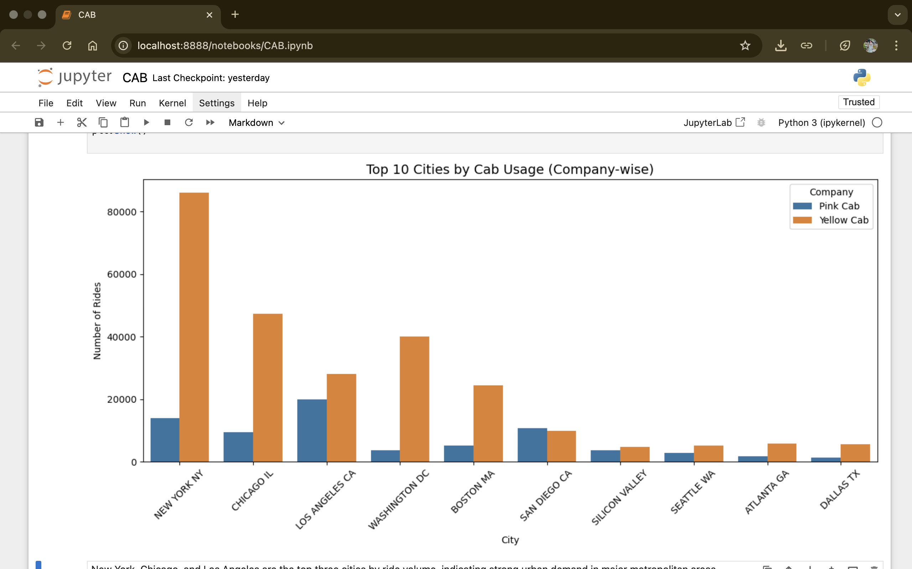
3. City-Wise Cab Usage
Top Cities by Ride Volume(Split by company)
Yellow Cab dominates in high-density cities like New York and Chicago, suggesting a larger and more active user base.

Slide 7
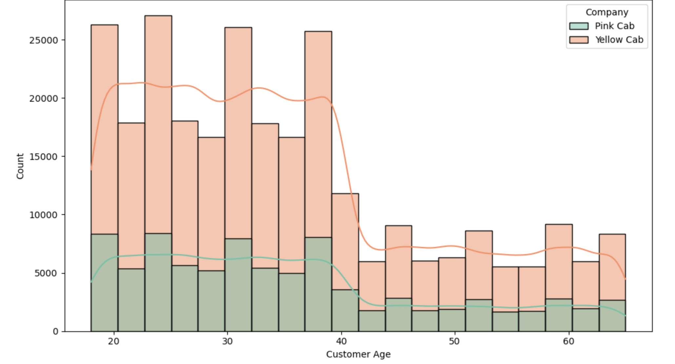
4. Age distribution Histogram
Age distribution of cab users by company
Yellow Cab dominates all age segments, especially the 25–40 age group; Pink Cab has a steady but smaller share across ages.

Slide 8
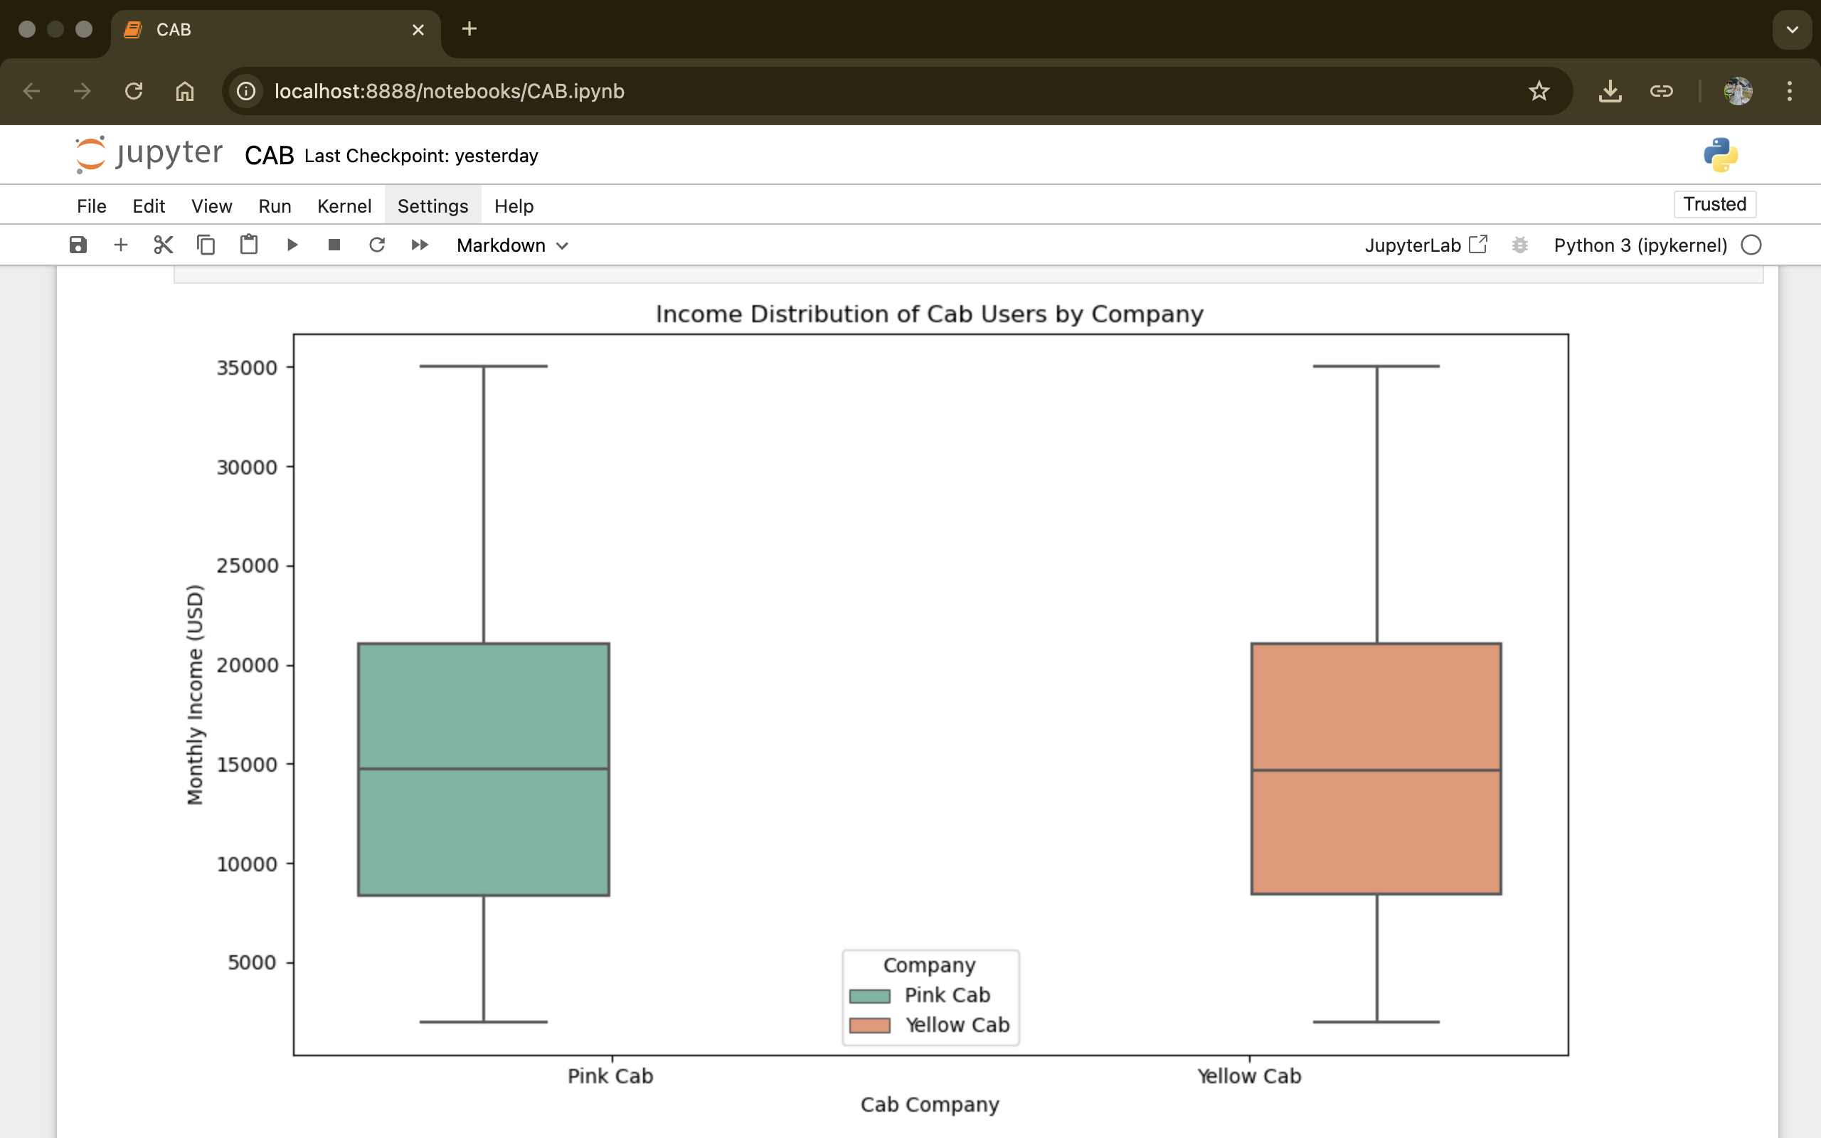
5. Income Distribution Box plot
Income distribution of Cab Users by Company
Both companies serve a wide range of income groups, but Pink Cab users skew slightly higher in income on average compared to Yellow Cab.

Slide 9
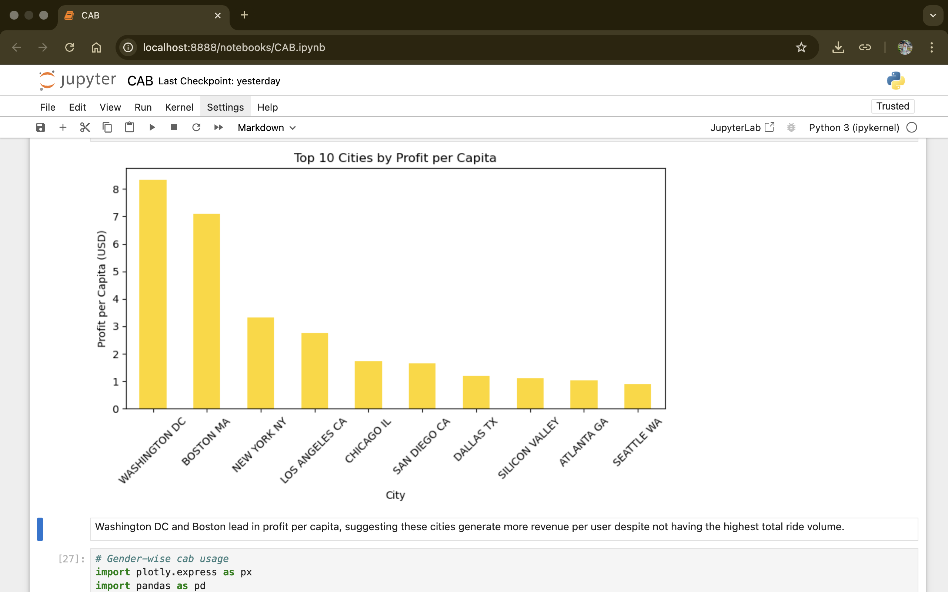
6. Profitability By Geography
Top 10 cities by Profit per Capita
Washington DC and Boston lead in profit per capita, highlighting cities where fewer users generate high revenue — signalling efficient market presence.

Slide 10
EDA SUMMARY
Yellow Cab handles over 3x more rides than Pink Cab, with consistent user base across major cities.
Despite lower ride volume, Pink Cab maintains strong average profit per ride, hinting at premium pricing or targeted users.
Profit margins and total revenue trends favor Yellow Cab across years, especially in high-density urban areas.
User demographics (age, income) suggest Yellow Cab appeals to a broader, middle-to-high income segment, while Pink Cab has a modest but steady presence.
Holiday demand, while lower in volume, does not significantly impact profitability, indicating stable operational efficiency.
Geographic insights show Washington DC and Boston have high profit per capita, pointing to strong monetization even with fewer rides.

Slide 11
Strategic Recommendations
Final Recommendation for Investment Decision
Based on profitability trends, customer demographics, and ride volume, Yellow Cab demonstrates stronger growth potential and operational scale.
Its high ride volume, broad market coverage, and strong margins position it as a resilient and scalable investment opportunity.
It is recommended that XYZ proceeds with investment in Yellow Cab, with an emphasis on expanding high-performing cities (e.g., Washington DC, Boston).
Optionally, Pink Cab could be evaluated for niche premium segments or partnerships, particularly in cities showing steady per-ride profitability.

Slide 12
Thank You

